Slide 1

Vibe Coding
with ApeChain_

Slide 2
Vibe Check
What do you understand by Vibe Coding?

Slide 3
Vibe Check
Live demo_
v0.app

Slide 4
Some important truths
As for now (mid 2025) LLMs actually can’t reason like a human, they are merely Stochastic Parrots
Most problems worth solving would still require a human in the loop, even when using modern large models
You still need some good understanding about software architecture to deploy a fully working app

Slide 5
Maximum Vibes
The real power of Vibe Coding is to shorten the development cycle from idea to prototype, from weeks or days to just a few hours, maybe even minutes
Also, for software developers, these AI coding tools can automate many grindy/repetitive tasks, like writing unit tests, documentation and such

Slide 6
Caution
Warning
Danger ahead

Slide 7
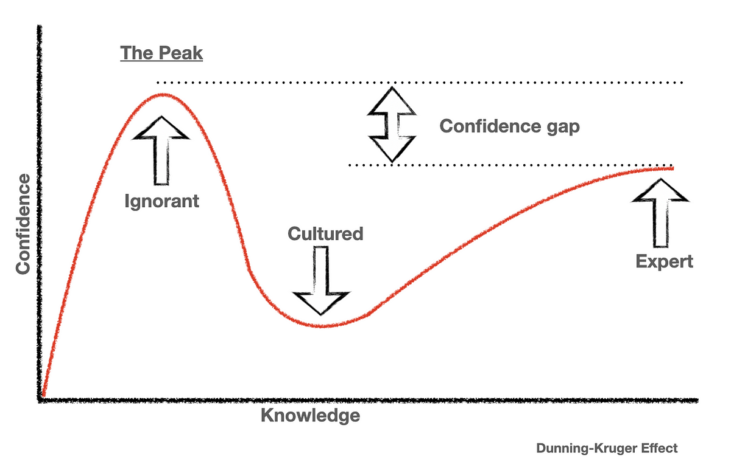
The journey of learning how to vibe code

Slide 8
Possible traps
The UI looks good
(but the code is messed up)
The app works partially
(but there are crucial missing parts in the backend)
The app works well from the user perspective
(but there are several vulnerabilities)

Slide 9
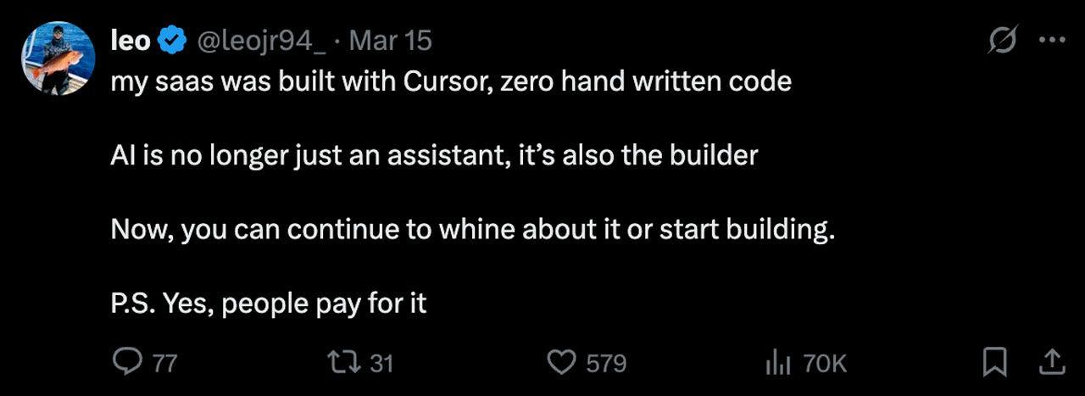
If it works, don’t touch it, right?

Slide 10
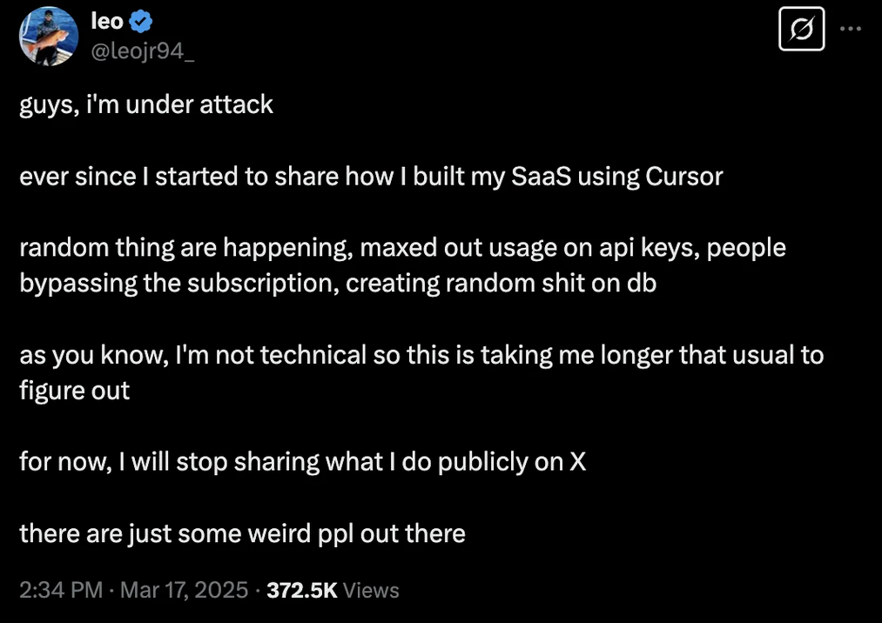
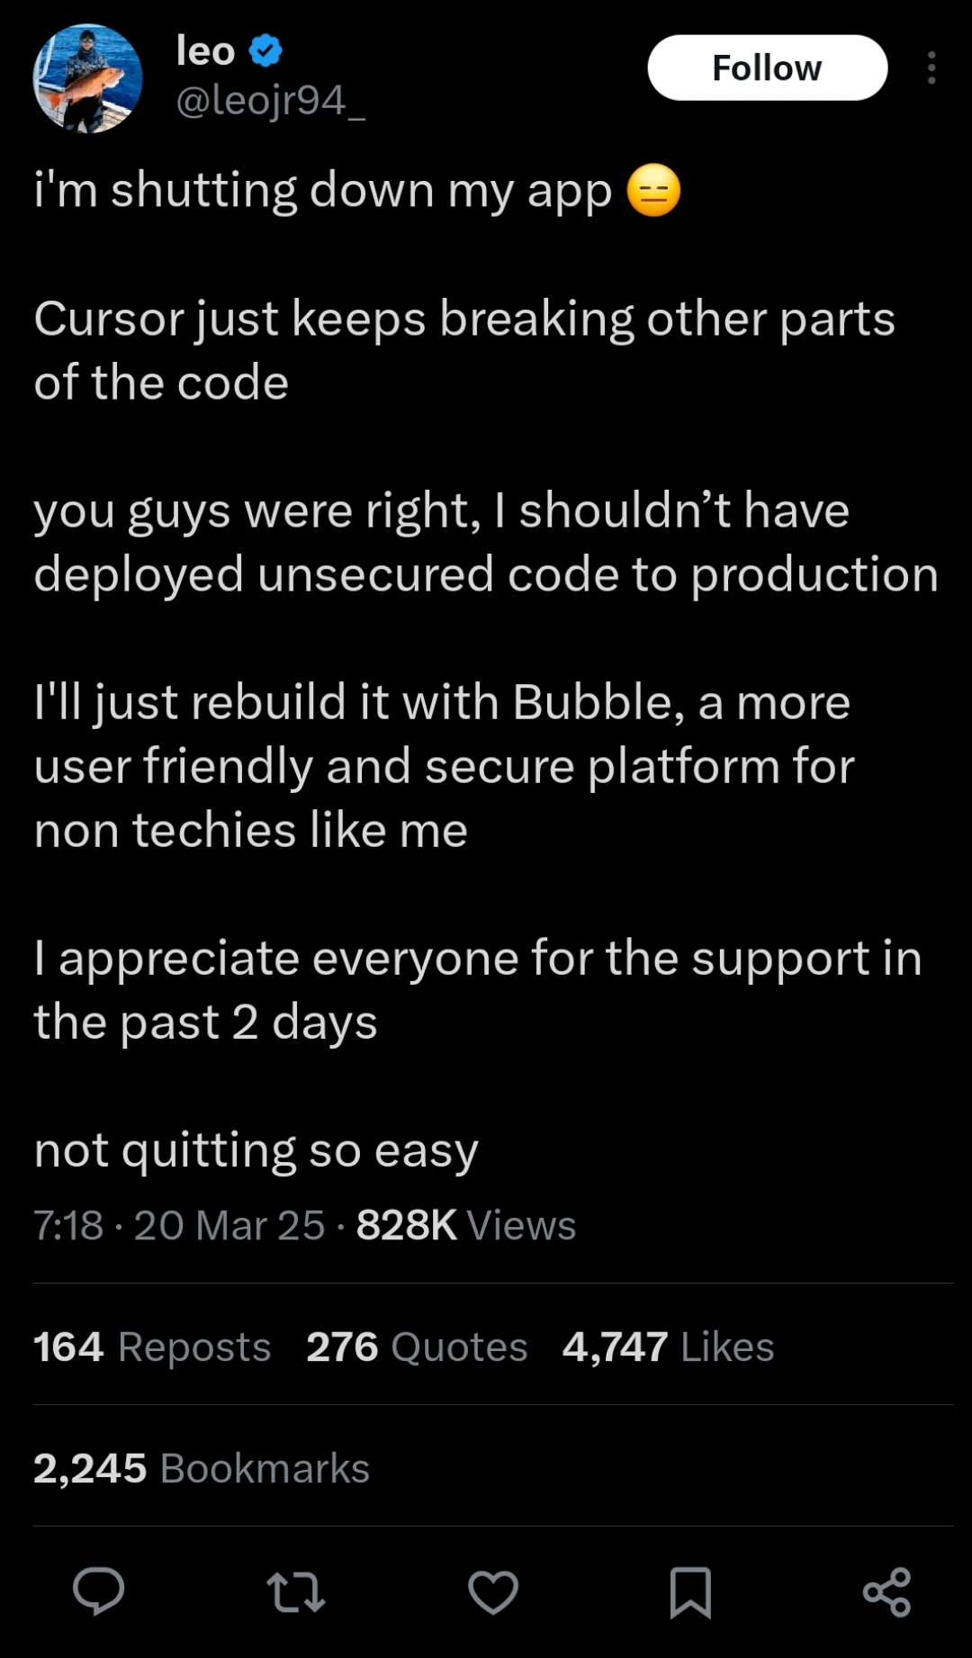
What is the problem with just a few bugs?

Slide 11
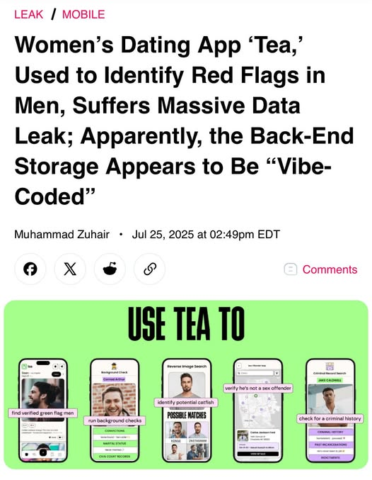
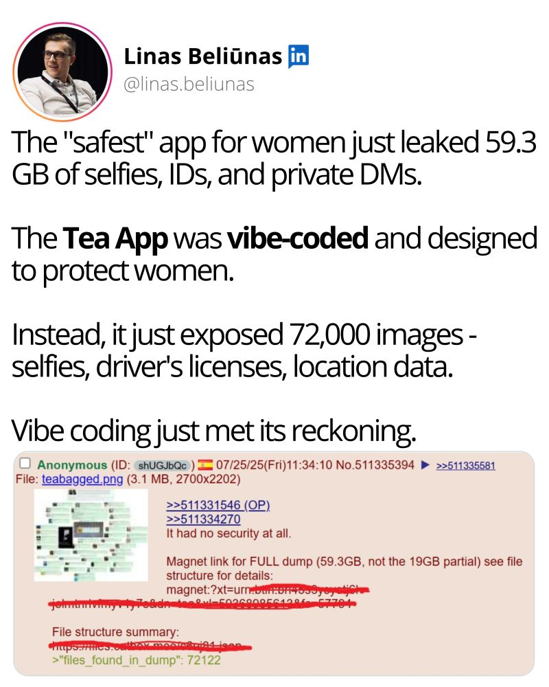
Be extra careful when handling sensitive data

Slide 12
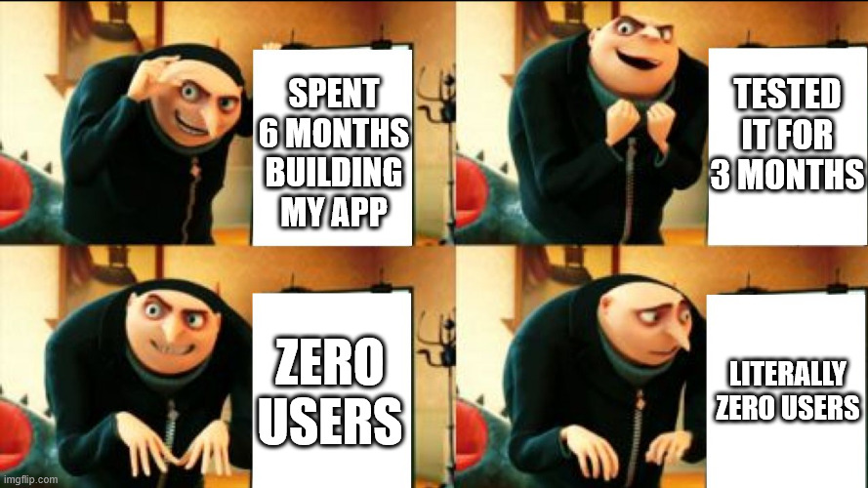
Over engineering is bad too

Slide 13
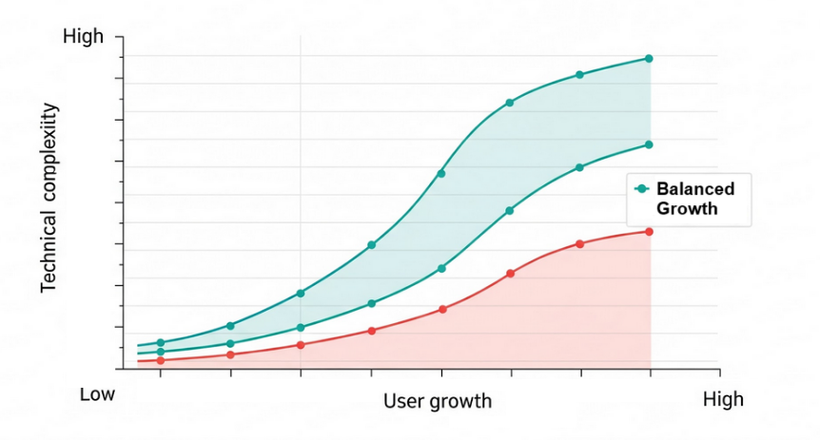
Finding balance

Slide 14
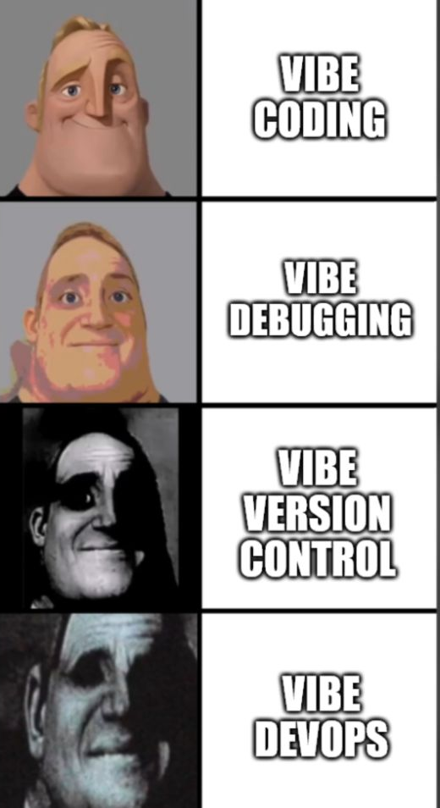
Find the best balance for each stage
Creating prototypes: Great!
Creating applications: OK…
Adding features: Maybe not?
Scaling products: Stop! Seek help.

Slide 15
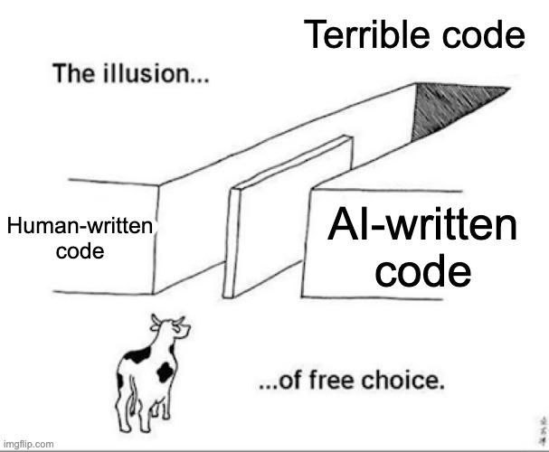
Not only AIs make Slop Code

Slide 16
Suggested steps
Step 00_
Validate the pain you are solving
Create a PRD for my app
Interview people + research problem

Slide 17
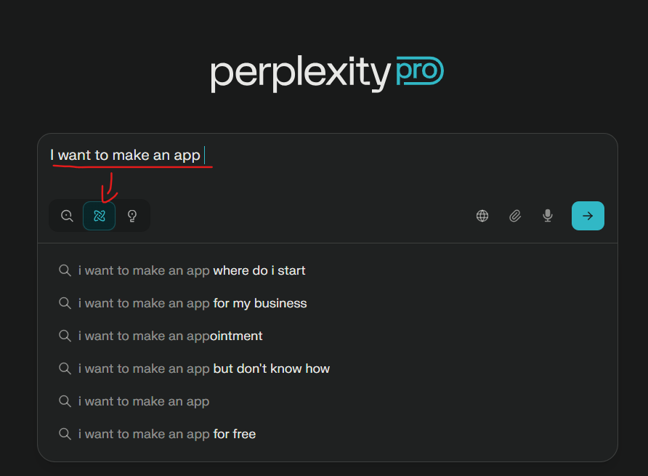
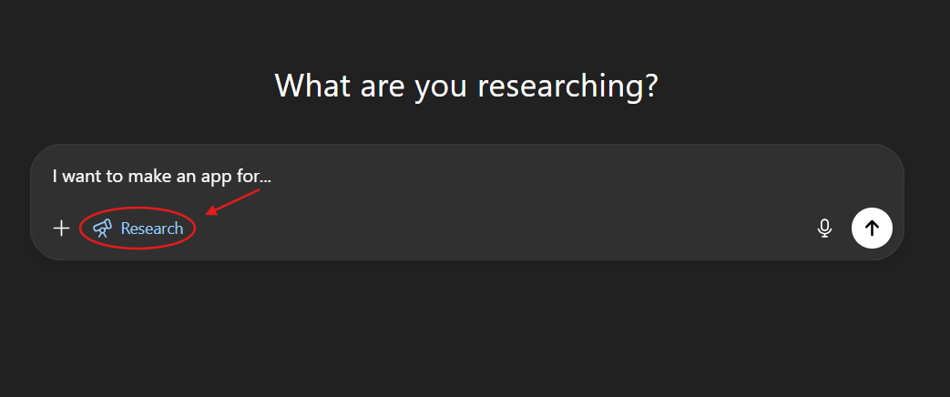
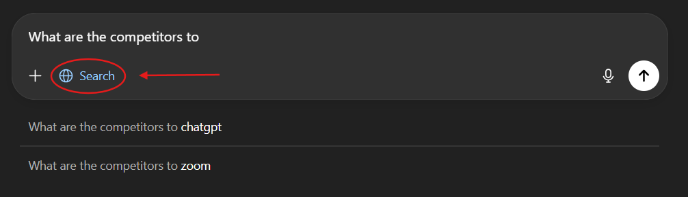
Suggestion: Research with AI

Slide 18
Suggested steps
Step 00_
Outcome: Define your idea in a single sentence
My app <Name> is <Defined Offering> to help <Defined Audience> <Solve a Problem> with <Secret Sauce>

Slide 19
Suggested steps
Step 01_
Validate your idea
Build a landing page/document and test your assumptions against <n> different individuals

Slide 20
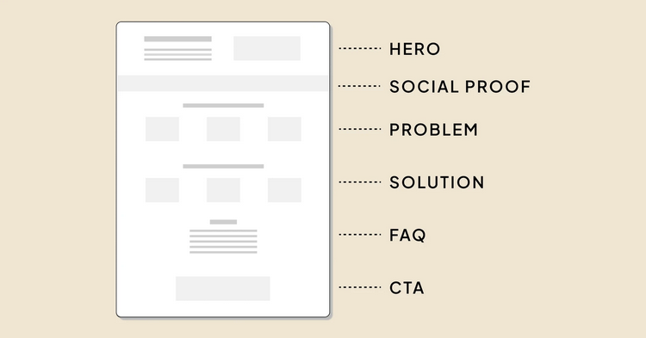
Suggestion: Create a Landing Page with a CTA

Slide 21
Suggested steps
Step 01_
Outcome: Get <x> users to interact with your CTA
You can use a waitlist, google form, social media link, or any similar CTA for validating interest

Slide 22
Suggested steps
Step 02_
Build a prototype
Build a minimally working prototype for showcasing your proposed solution

Slide 23
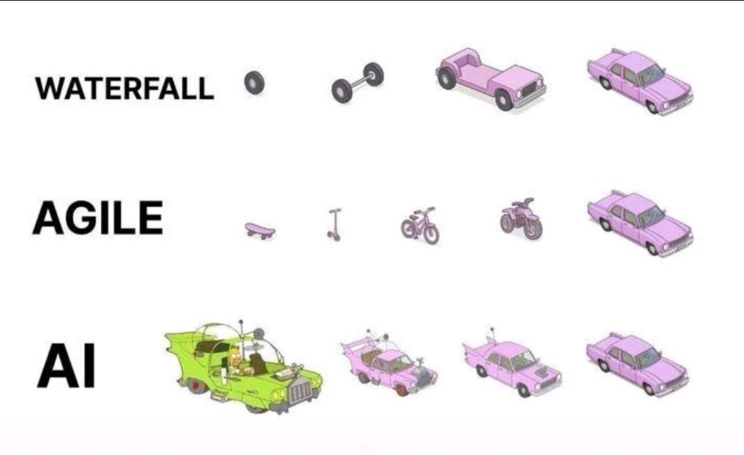
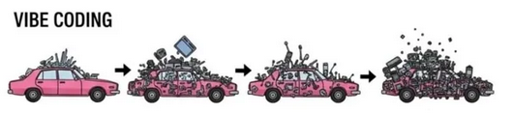
Suggestion: Build a Prototype with Gen. AI

Slide 24
Suggested steps
Step 02_
Outcome: Get <y> users to use your prototype
Collect feedback directly from your ICP to determine whether or not the proposed solution would work

Slide 25
Suggested steps
Step 03_
Build a MVP
Figure out what would be the minimal solution to solve the problem in a viable way

Slide 26
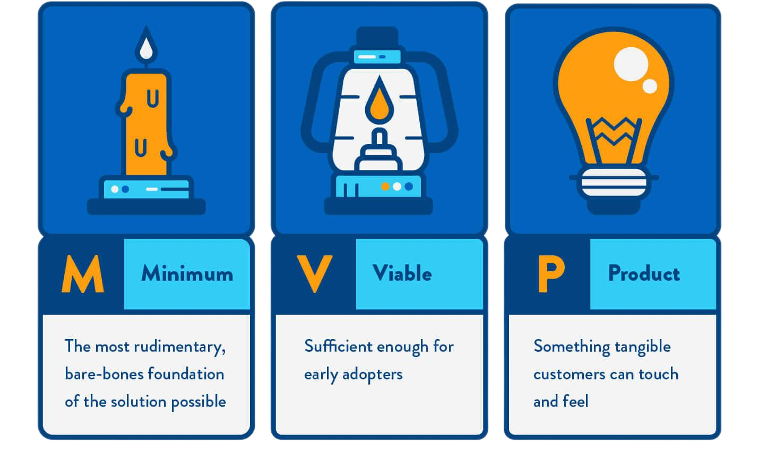
Suggestion: Seek experts to assist you here

Slide 27
Suggested steps
Step 03_
Outcome: Get <z> users to pay for using your MVP
This is the critical step to discover if your app has Product-Market Fit or not

Slide 28
Suggested steps
Iterate back and forth between steps until you finally find an offer for what your customers are willing to pay enough so that it is sustainable for your business
Vibe Coding can speed up this iteration process from months to just a few days

Slide 29
Suggested steps
Step 04_
Build a Business
Once you are sure of your PMF, it is time to do all the homework you skipped and build a real business

Slide 30
You made it!
What will you Vibe Code today?

